Slide 1
Digit Recognition
Lee and Ran
Future Learning, Course 1
Dec, 2017

Slide 2
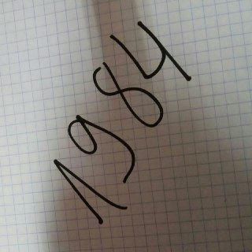
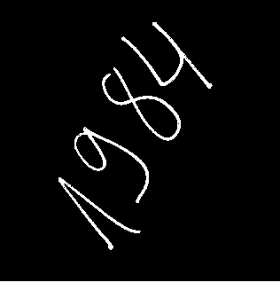
Load Image in grayscale
Apply threshold for binary representation
img = cv2.imread('big-Num1.jpg', 0)
ret, thresh = cv2.threshold(img, 40, 255, cv2.THRESH_BINARY)
thresh = abs(thresh.astype(float) - 255)
thresh = thresh.astype('uint8')
cv2.imshow("thresh", thresh)

Slide 3
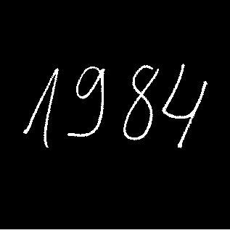
ROTATION
coords = np.column_stack(np.where(thresh > 0))
angle = cv2.minAreaRect(coords)[-1]
if angle < -45:
angle = -angle
else:
angle = - (90 + angle)
(h, w) = thresh.shape[:2]
center = (w // 2, h // 2)
M = cv2.getRotationMatrix2D(center, angle, 1.0)
rotated = cv2.warpAffine(thresh, M, (w, h), flags=cv2.INTER_CUBIC, borderMode=cv2.BORDER_REPLICATE)

Slide 4
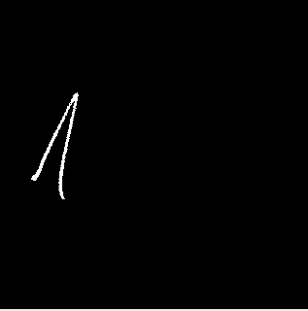
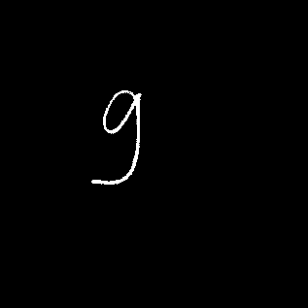

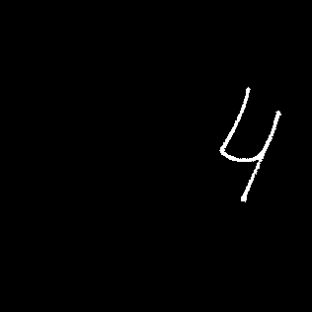
Segmentation
ret, markers = cv2.connectedComponents(rotated, connectivity=8)
marker = (markers == i).astype('uint8') * 255
_, contours, hierarchy = cv2.findContours(marker, 2, 2)
cnt = contours[0]
x, y, w, h = cv2.boundingRect(cnt)

Slide 5
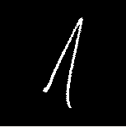
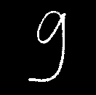

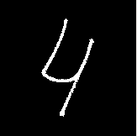
Center, pad, resize to 28X28, threshold
square_edge = np.maximum(h, w)
square_edge = int(square_edge * 1.4)
top_bottom_padding = ((square_edge-h)/2, (square_edge-h)/2)
right_left_padding = ((square_edge-w)/2, (square_edge-w)/2)
only_digit = marker[y:y+h, x:x+w]
only_digit = np.pad(only_digit, [top_bottom_padding, right_left_padding], mode='constant')
resized_image = cv2.resize(only_digit, (28, 28), interpolation = cv2.INTER_AREA)
resized_image = (resized_image > 40).astype('uint8') * 255

Slide 6
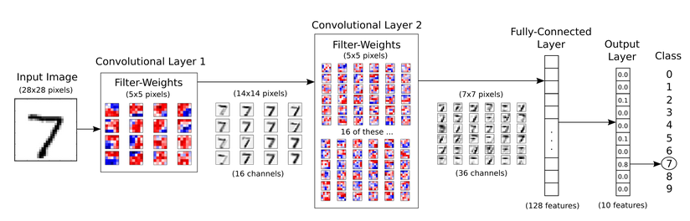
Max pooling [2X2]->1
16 filters -> 16 images (channels)
Downsample: Each image 14X14 pixels
16 (images) x 36 (dedicated filters) = 576 filters
Downsample: Each image 7X7 pixels

Slide 7
Convolutional Neural Network
Tensor Flow
Based on:
https://github.com/Hvass-Labs/TensorFlow-Tutorials/blob/master/02_Convolutional_Neural_Network.ipynb

Slide 8
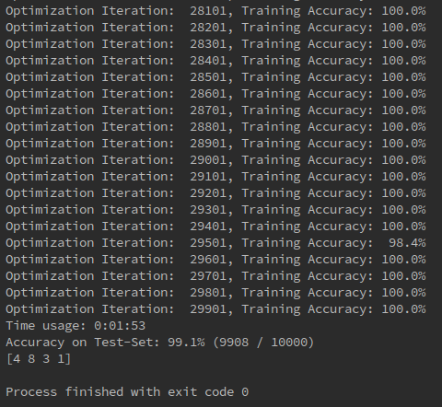

Slide 9



Slide 10





Gaussian Blurring at different levels
resized_image = cv2.GaussianBlur(resized_image, (3, 3), 0)
kernel = np.ones((2, 2), np.uint8)
resized_image = cv2.dilate(resized_image, kernel, iterations=1)

Slide 11
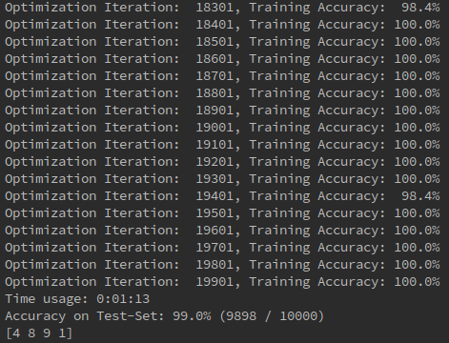
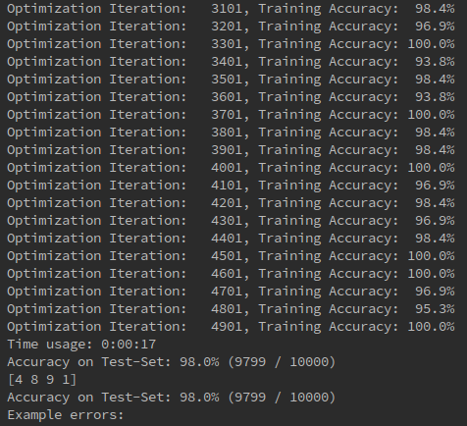

Slide 12




Extra Info

